Slide 1
AZ-900T00 Learning path 02: Azure architecture and services
Notes:
Learn learning path:
https://learn.microsoft.com/training/paths/azure-fundamentals-describe-azure-architecture-services/

Slide 2

Learning path 02―outline
You will learn the following concepts:
1
Azure architectural components
Regions and availability zones
Subscriptions and resource groups
2
Compute and networking
Compute types
Application hosting
Virtual networking
3
Storage
Storage services
Redundancy options
File management and migration
4
Identity, access, and security
Directory services
Authentication methods
Security models

Slide 3
Azure accounts
Azure account
Azure free account
Azure free student account
Microsoft Learn sandbox
Notes:
https://learn.microsoft.com/training/modules/describe-core-architectural-components-of-azure/3-get-started-azure-accounts

Slide 4
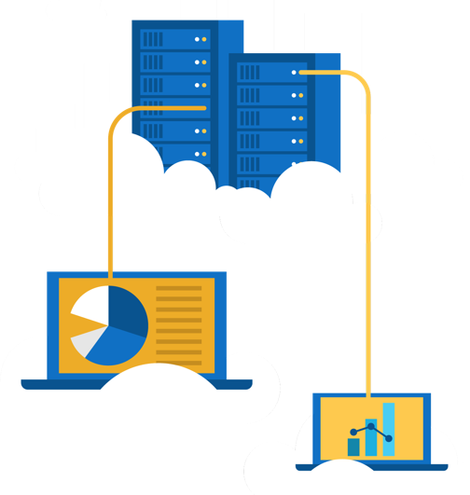
Walkthrough―create an Azure account
Create a free Azure account
Create a free Azure free account.
Notes:
https://learn.microsoft.com/training/modules/create-an-azure-account/
Most exercises will be in the Learn Sandbox―in the last module, there’s a portion that needs an Azure account or can be converted to Demo. This is an optional exercise to help the students create free accounts. Note: They will need a credit card for this exercise.

Slide 5
Azure architectural components
Notes:
https://learn.microsoft.com/training/modules/describe-core-architectural-components-of-azure/1-introduction

Slide 6
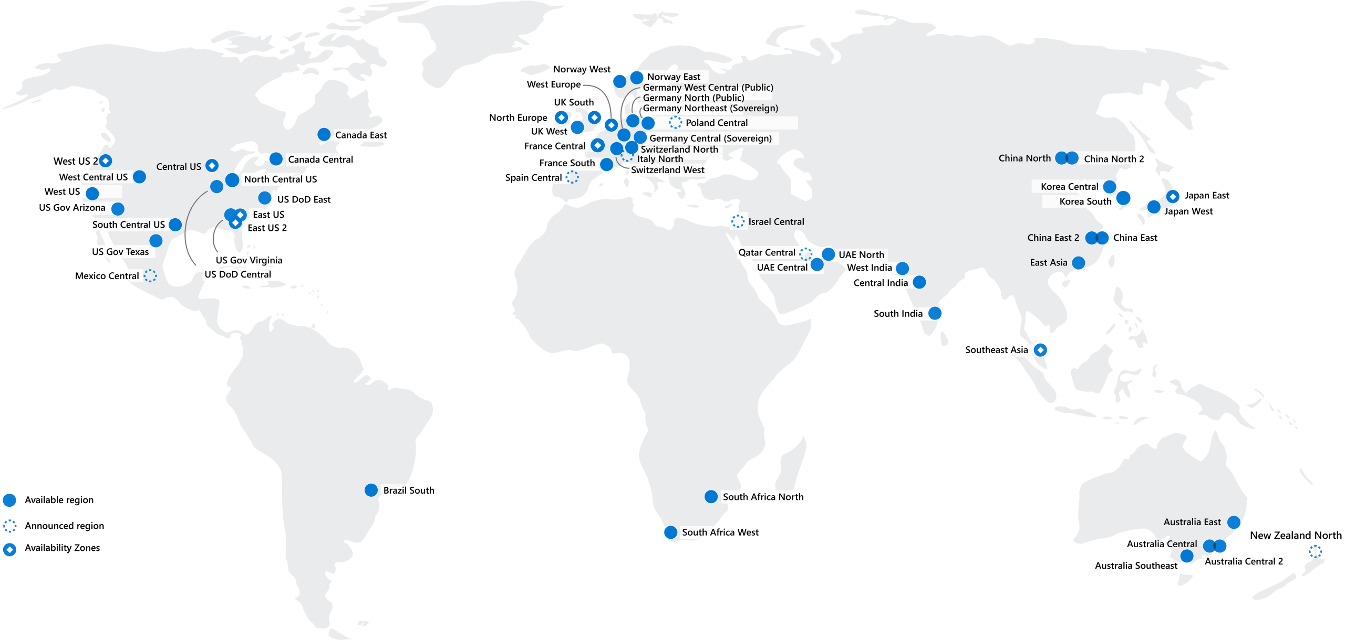
Regions
Azure offers more global regions than any other cloud provider with 60-plus regions representing over 140 countries
Regions are made up of one or more datacenters in close proximity.
They provide flexibility and scale to reduce customer latency.
Regions preserve data residency with a comprehensive compliance offering.
Notes:
https://learn.microsoft.com/training/modules/describe-core-architectural-components-of-azure/5-describe-azure-physical-infrastructure
A region represents a collection of datacenters.
They provide flexibility and scale.
Regions preserve data residency.
You can select regions close to your users.
Be aware of region deployment availability.
There are global services that are region independent.
A list of regions and their locations is available at https://azure.microsoft.com/explore/global-infrastructure/data-residency/#overview

Slide 7
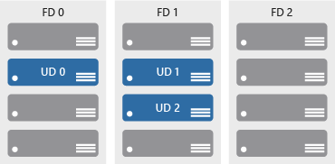

Availability zones
Provide protection against downtime due to datacenter failure.
Physically separate datacenters within the same region.
Each datacenter is equipped with independent power, cooling, and networking.
Connected through private fiber-optic networks.
Azure Region
Availability Zone 1
Availability Zone 2
Availability Zone 3
Notes:
https://learn.microsoft.com/training/modules/describe-core-architectural-components-of-azure/5-describe-azure-physical-infrastructure
Physically separate locations within an Azure region.
Takes availability sets to the next level
Includes one or more datacenters, equipped with independent power, cooling, and networking.
Acts as an isolation boundary.
If one availability zone goes down, the other continues working.
More details about Availability Zones in Azure are available at https://learn.microsoft.com/azure/reliability/availability-zones-overview

Slide 8
Region pairs
At least 300 miles of separation between region pairs.
Automatic replication for some services.
Prioritized region recovery in the event of outage.
Updates are rolled out sequentially to minimize downtime.
Web link: https://aka.ms/PairedRegions
Region
North Central US​
East US​
West US 2​
US East 2​
Canada Central​
North Europe​
UK West​
Germany Central​
South East Asia​
East China​
Japan East​
Australia Southeast​
India South​
Brazil South (Primary)​
Region
South Central US​
West US​
West Central US​
Central US​
Canada East​
West Europe​
UK South​
Germany Northeast​
East Asia​
North China​
Japan West​
Australia East​
India Central​
South Central US ​
Notes:
https://learn.microsoft.com/training/modules/describe-core-architectural-components-of-azure/5-describe-azure-physical-infrastructure
Each Azure region is paired with another region.
Azure prefers at least 300 miles of separation between datacenters in a regional pair.
Some services provide automatic replication to the paired region.
In an outage, recovery of one region is prioritized out of every pair.
Azure system updates are rolled out to paired regions sequentially (not at the same time).
For a list of geographies, regions, region-pairs, and other details, go to https://azure.microsoft.com/explore/global-infrastructure/geographies/#overview
For a full list of region pairs, go to https://learn.microsoft.com/azure/reliability/cross-region-replication-azure#what-are-paired-regions

Slide 9
Azure sovereign regions (US government services)
Meets the security and compliance needs of US federal agencies, state and local governments, and their solution providers.
Azure government:
Separate instance of Azure.
Physically isolated from non-US government deployments.
Accessible only to screened, authorized personnel.
Notes:
https://learn.microsoft.com/training/modules/describe-core-architectural-components-of-azure/5-describe-azure-physical-infrastructure
Azure Government - https://azure.microsoft.com/en-us/global-infrastructure/government/

Slide 10
Azure sovereign regions (Azure China)
Microsoft is China’s first foreign public cloud service provider, in compliance with government regulations.
Azure China features:
Physically separated instance of Azure cloud services operated by 21Vianet.
All data stays within China to ensure compliance.
Notes:
https://learn.microsoft.com/training/modules/describe-core-architectural-components-of-azure/5-describe-azure-physical-infrastructure
Azure China 21Vianet - https://learn.microsoft.com/azure/china/

Slide 11
Walkthrough―explore the Azure global infrastructure
Explore the Azure global infrastructure
Select Explore the Globe (after intro).
Notice the different icons (geography, regions, points of presence (PoP), and so on).
Find your location on the globe, then find the nearest PoP and region to your location.
Notes:
https://datacenters.microsoft.com/globe/

Slide 12






Azure resources
Azure resources are components like storage, virtual machines, and networks that are available to build cloud solutions.
Virtual machines
Storage accounts
Virtual networks
App services
SQL databases
Functions
Notes:
https://learn.microsoft.com/training/modules/describe-core-architectural-components-of-azure/6-describe-azure-management-infrastructure

Slide 13



Resource groups
A resource group is a container you use to manage and aggregate resources in a single unit.
Resources can exist in only one resource group.
Resources can exist in different regions.
Resources can be moved to different resource groups.
Applications can utilize multiple resource groups.
Resource groups (web plus DB, VM, storage) in one group
OR
Web and DB resource group
Virtual machine resource group
Storage resource group
Notes:
https://learn.microsoft.com/training/modules/describe-core-architectural-components-of-azure/6-describe-azure-management-infrastructure
Containers for multiple resources that share the same life cycle.
Aggregates resources into a single manageable unit.
Every Azure resource must exist in one (and only one) resource group.
Secure at the resource group (or resource) level―using role-based access control (RBAC).

Slide 14
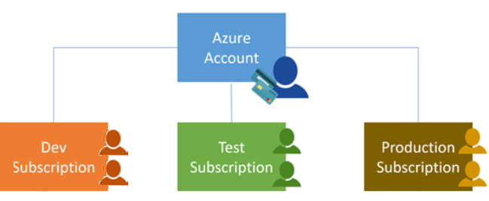
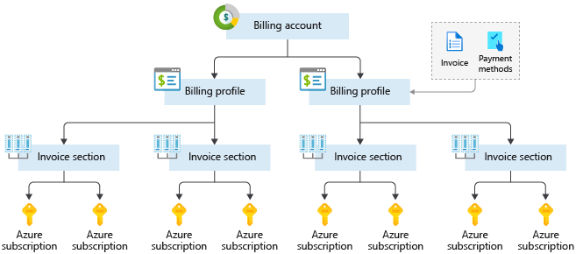
Azure subscriptions
An Azure subscription provides you with authenticated and authorized access to Azure accounts.
Billing boundary: Generate separate billing reports and invoices for each subscription.
Access control boundary: Manage and control access to the resources that users can provision with specific subscriptions.
Notes:
https://learn.microsoft.com/training/modules/describe-core-architectural-components-of-azure/6-describe-azure-management-infrastructure
An account can have one or multiple subscriptions.
Azure subscription offers: https://azure.microsoft.com/en-us/support/legal/offer-details/

Slide 15
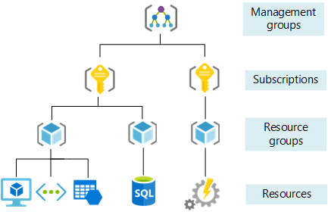
Management groups
Management groups can include multiple Azure subscriptions.
Subscriptions inherit conditions applied to the management group.
10,000 management groups can be supported in a single directory.
A management group tree can support up to six levels of depth.
Notes:
https://learn.microsoft.com/training/modules/describe-core-architectural-components-of-azure/6-describe-azure-management-infrastructure
Management groups can include multiple Azure subscriptions.
Subscriptions inherit conditions applied to the management group.
10,000 management groups can be supported in a single directory.
A management group tree can support up to six levels of depth.
Management groups: https://learn.microsoft.com/azure/governance/management-groups/

Slide 16
Compute and networking
Notes:
https://learn.microsoft.com/training/modules/describe-azure-compute-networking-services/

Slide 17
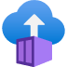
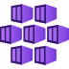

Azure compute services
Azure compute is an on-demand service that provides computing resources such as disks, processors, memory, networking, and operating systems.
Virtual
Machines
App
Services
Container Instances
Azure Kubernetes Services (AKS)
Azure Virtual Desktop
Notes:
https://azure.microsoft.com/products/category/compute/

Slide 18
Azure virtual machines
Azure virtual machines (VMs) are software emulations of physical computers.
Includes virtual processor, memory, storage, and networking.
IaaS offering that provides total control and customization.
Notes:
https://learn.microsoft.com/training/modules/describe-azure-compute-networking-services/2-virtual-machines
Development and test: Azure VMs offer a quick and easy way to create a computer with specific configurations required to code and test an application.
Applications in the cloud: Because demand for your application can fluctuate, it might make economic sense to run it on a VM in Azure. You pay for extra VMs when you need them and shut them down when you don’t.
Extended datacenter: Virtual machines in an Azure virtual network can easily be connected to your organization’s network.
Azure virtual machines: https://azure.microsoft.com/en-us/services/virtual-machines/

Slide 19
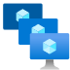
VM scale sets
Scale sets provide a load-balanced opportunity to automatically scale resources.
Scale out when resource needs increase.
Scale in when resource needs are lower.
Notes:
https://learn.microsoft.com/training/modules/describe-azure-compute-networking-services/2-virtual-machines

Slide 20
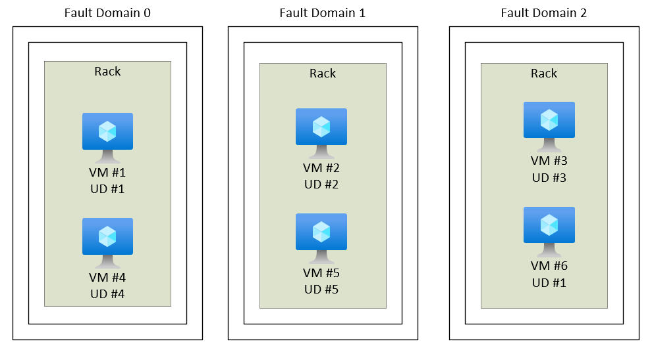
VM availability sets
Notes:
https://learn.microsoft.com/training/modules/describe-azure-compute-networking-services/2-virtual-machines
Update domain keeps VMs grouped if they can be rebooted at the same time without causing an outage.
Fault domains group VMs based on common power and networking.

Slide 21
Azure Virtual Desktop
Azure Virtual Desktop is a desktop and app virtualization that runs in the cloud.
Create a full desktop virtualization environment without having to run additional gateway servers.
Reduce risk of resource being left behind.
True multisession deployments.
Notes:
https://learn.microsoft.com/training/modules/describe-azure-compute-networking-services/4-virtual-desktop
https://learn.microsoft.com/azure/virtual-desktop/overview

Slide 22

Azure container services
Azure containers provide a lightweight, virtualized environment that does not require operating system management, and can respond to changes on demand.
Azure Container Instances: A PaaS offering that runs a container or pod of containers in Azure.
Azure Container Apps: A PaaS offering, like container instances, that can load balance and scale.
Azure Kubernetes Service: An orchestration service for containers with distributed architectures and large volumes of containers.
Notes:
https://learn.microsoft.com/training/modules/describe-azure-compute-networking-services/5-containers
Containers are a virtualization environment. However, unlike virtual machines, you do not manage an operating system. Containers are meant to be lightweight, and are designed to be created, scaled out, and stopped dynamically.
Azure Container Instances: https://azure.microsoft.com/en-us/services/container-instances/
Azure Kubernetes Service: https://azure.microsoft.com/en-us/services/kubernetes-service/

Slide 23
Azure Functions
Azure Functions: A PaaS offering that supports serverless compute operations. Event-based code runs when called without requiring server infrastructure during inactive periods.
Notes:
https://learn.microsoft.com/training/modules/describe-azure-compute-networking-services/6-functions
Serverless computing is the evolution of cloud platforms in the direction of pure cloud native code. Serverless brings developers closer to business logic while insulating them from infrastructure concerns. It's a pattern that doesn't imply "no server" but rather, "less server." Serverless code is event-driven. Code may be triggered by anything from a traditional HTTP web request to a timer or the result of uploading a file. The infrastructure behind serverless allows for instant scale to meet elastic demands and offers microbilling to truly "pay for what you use." Serverless requires a new way of thinking and approach to building applications and isn't the right solution for every problem.
Azure Functions is code that runs your service and not the underlying platform or infrastructure. Creates infrastructure based on an event.

Slide 24
Comparing Azure compute options
Virtual machines
Virtual Desktop
Containers
Cloud-based server that supports either Windows or Linux environments.
Useful for lift-and-shift migrations to the cloud.
Complete operating system package, including the host operating system.
Provides a cloud-based personal computer Windows desktop experience.
Dedicated applications to connect and use, or accessible from any modern browser.
Multiclient login allows multiple users to log into the same machine at the same time.
Lightweight, miniature environment well suited for running microservices.
Designed for scalability and resiliency through orchestration.
Applications and services are packaged in a container that sits on top of the host operating system. Multiple containers can sit on one host OS.

Slide 25

Azure App Services
Azure App Services is a fully managed platform to build, deploy, and scale web apps and APIs quickly.
Works with .NET, .NET Core, Node.js, Java, Python, or php.
PaaS offering with enterprise-grade performance, security, and compliance requirements.
Notes:
https://learn.microsoft.com/training/modules/describe-azure-compute-networking-services/7-describe-application-hosting-options

Slide 26
Azure networking services
Azure Virtual Network (VNet) enables Azure resources to communicate with each other, the internet, and on-premises networks.
Public endpoints, accessible from anywhere on the internet.
Private endpoints, accessible only from within your network.
Virtual subnets segment your network to suit your needs.
Network peering connects your private networks directly together.
Notes:
https://learn.microsoft.com/training/modules/describe-azure-compute-networking-services/8-virtual-networking

Slide 27
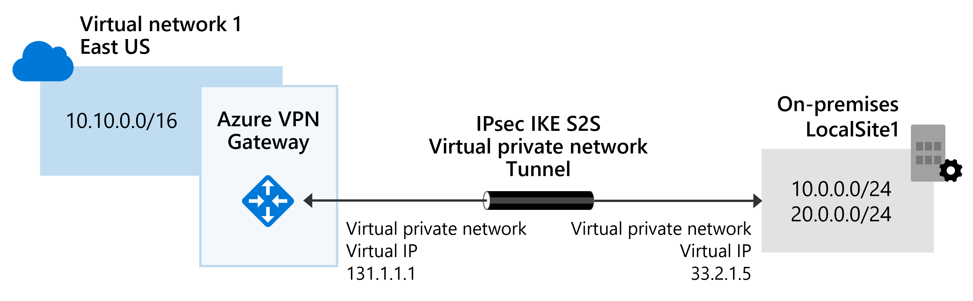

Azure networking services: VPN Gateway
VPN Gateway is used to send encrypted traffic between an Azure virtual network and an on-premises location over the public internet.
Notes:
https://learn.microsoft.com/training/modules/describe-azure-compute-networking-services/10-virtual-private-networks

Slide 28
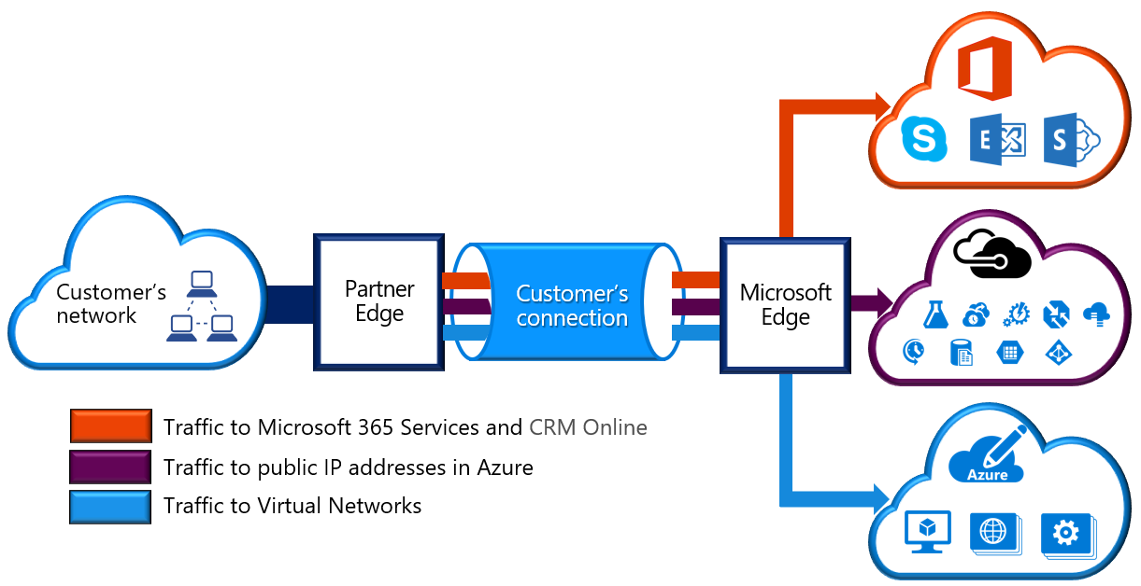
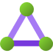
Azure networking services: ExpressRoute
ExpressRoute extends on-premises networks into Azure over a private connection that is facilitated by a connectivity provider.
Notes:
https://learn.microsoft.com/training/modules/describe-azure-compute-networking-services/11-expressroute/

Slide 29

Azure DNS
Reliability and performance by leveraging a global network of DNS name servers using Anycast networking.
Azure DNS security is based on Azure resource manager, enabling role-based access control and monitoring and logging.
Ease of use for managing your Azure and external resources with a single DNS service.
Customizable virtual networks allow you to use private, fully customized domain names in your private virtual networks.
Alias records support alias record sets to point directly to an Azure resource.
Notes:
https://learn.microsoft.com/training/modules/describe-azure-compute-networking-services/12-domain-name-system

Slide 30
Storage
Notes:
https://learn.microsoft.com/training/modules/describe-azure-storage-services/

Slide 31

Storage accounts
Must have a globally unique name.
Provide over-the-internet access worldwide.
Determine storage services and redundancy options.
Notes:
https://learn.microsoft.com/training/modules/describe-azure-storage-services/2-accounts

Slide 32
Storage redundancy
Redundancy configuration | Deployment | Durability
Locally redundant storage (LRS) | Single datacenter in the primary region | 11 nines
Zone-redundant storage (ZRS) | Three availability zones in the primary region | 12 nines
Geo-redundant storage (GRS) | Single datacenter in the primary and secondary region | 16 nines
Geo-zone-redundant-storage (GZRS) | Three availability zones in the primary region and a single datacenter in the secondary region | 16 nines
Notes:
https://learn.microsoft.com/training/modules/describe-azure-storage-services/3-redundancy

Slide 33




Azure storage services
Azure Blob: Optimized for storing massive amounts of unstructured data, such as text or binary data.
Azure Disk: Provides disks for virtual machines, applications, and other services to access and use.
Azure Queue: Message storage service that provides storage and retrieval for large amounts of messages, each up to 64 KB.
Azure Files: Sets up a highly available network file share that can be accessed by using the Server Message Block protocol.
Azure Tables: Provides a key/attribute option for structured nonrelational data storage with a schema-less design.
Notes:
https://learn.microsoft.com/training/modules/describe-azure-storage-services/4-describe-azure-storage-services

Slide 34
Storage service public endpoints
Storage service | Public endpoint
Blob Storage | https://<storage-account-name>.blob.core.windows.net
Data Lake Storage Gen2 | https://<storage-account-name>.dfs.core.windows.net
Azure Files | https://<storage-account-name>.file.core.windows.net
Queue Storage | https://<storage-account-name>.queue.core.windows.net
Table Storage | https://<storage-account-name>.table.core.windows.net

Slide 35
Azure storage access tiers
Hot | Cool | Cold | Archive
Optimized for storing data that is accessed frequently. | Optimized for storing data that is infrequently accessed and stored for at least 30 days. | Optimized for storing data that is infrequently accessed and stored for at least 90 days. | Optimized for storing data that is rarely accessed and stored for at least 180 days with flexible latency requirements.
Notes:
https://learn.microsoft.com/training/modules/describe-azure-storage-services/4-describe-azure-storage-services

Slide 36

Azure Migrate
Unified migration platform.
Range of integrated and standalone tools.
Assessment and migration.
Notes:
https://learn.microsoft.com/training/modules/describe-azure-storage-services/6-identify-azure-data-migration-options

Slide 37

Azure Data Box
Store up to 80 terabytes of data.
Move your disaster recovery backups to Azure.
Protect your data in a rugged case during transit.
Migrate data out of Azure for compliance or regulatory needs.
Migrate data to Azure from remote locations with limited or no connectivity.
Notes:
https://learn.microsoft.com/training/modules/describe-azure-storage-services/6-identify-azure-data-migration-options

Slide 38
File management options
AzCopy
Azure Storage Explorer
Azure File Sync
Command-line utility.
Copy blobs or files to or from your storage account.
One-direction synchronization.
Graphical user interface (similar to Windows Explorer).
Compatible with Windows, MacOS, and Linux.
Uses AzCopy to handle file operations.
Synchronizes Azure and on-premises files in a bidirectional manner.
Cloud tiering keeps frequently accessed files local, while freeing up space.
Rapid reprovisioning of failed local server (install and resync).
Notes:
https://learn.microsoft.com/training/modules/describe-azure-storage-services/7-identify-azure-file-movement-options

Slide 39
Identity, access, and security
Notes:
https://learn.microsoft.com/training/modules/describe-azure-identity-access-security

Slide 40

Microsoft Entra ID
Microsoft Entra ID is Microsoft Azure’s cloud-based identity and access management service.
Authentication (employees sign in to access resources).
Single sign-on (SSO).
Application management.
Business to Business (B2B).
Device management.
Notes:
https://learn.microsoft.com/training/modules/describe-azure-identity-access-security/2-directory-services
Azure AD - https://azure.microsoft.com/en-us/services/active-directory/
Azure tenant
A dedicated and trusted instance of Azure AD that's automatically created when your organization signs up for a Microsoft cloud service subscription, such as Microsoft Azure, Microsoft Intune, or Office 365. An Azure tenant represents a single organization.
Azure AD directory
Each Azure tenant has a dedicated and trusted Azure AD directory. The Azure AD directory includes the tenant's users, groups, and apps and is used to perform identity and access management functions for tenant resources.

Slide 41
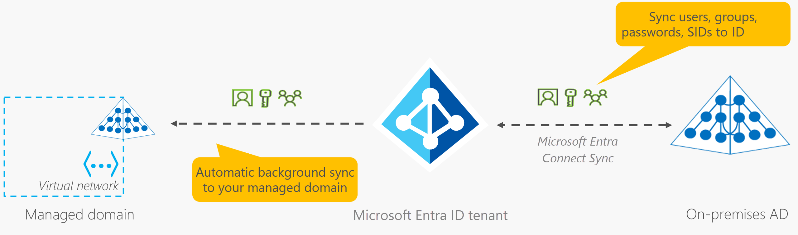
Microsoft Entra Domain Services
Gain the benefit of cloud-based domain services without managing domain controllers.
Run legacy applications (that can’t use modern auth standards) in the cloud.
Automatically sync from Microsoft Entra ID.
Notes:
https://learn.microsoft.com/training/modules/describe-azure-identity-access-security/2-directory-services
Microsoft Entra ID: https://www.microsoft.com/security/business/identity-access/microsoft-entra-id

Slide 42
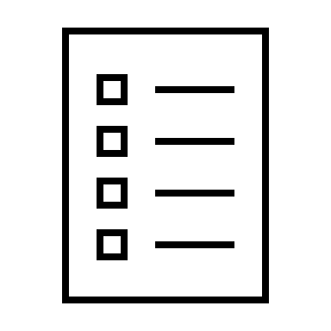








Compare authentication and authorization
Authentication
Authorization
Identifies the person or service seeking access to a resource.
Requests legitimate access credentials.
Basis for creating secure identity and access control principles.
Determines an authenticated person’s or service’s level of access.
Defines which data they can access, and what they can do with it.
Notes:
https://learn.microsoft.com/training/modules/describe-azure-identity-access-security/3-authentication-methods
✔️Authentication is sometimes shortened to AuthN, and authorization is sometimes shortened to AuthZ.
Authentication
Identifies the person or service seeking access to a resource.
Requests legitimate access credentials.
Basis for creating secure identity and access control principles.
Authorization
Determines an authenticated person’s or service’s level of access.
Defines which data they can access, and what they can do with it.

Slide 43
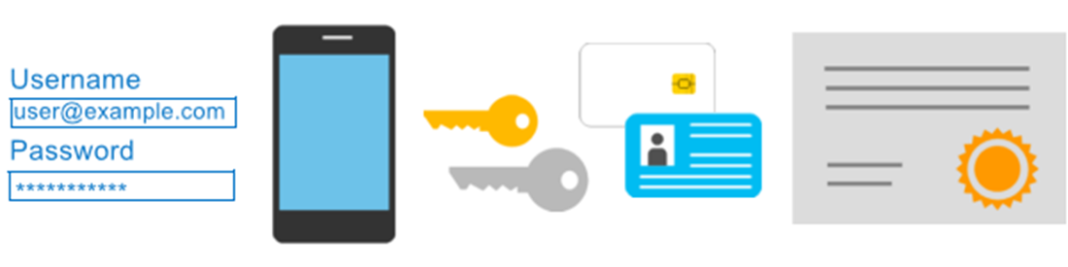
Multifactor authentication
Provides additional security for your identities by requiring two or more elements for full authentication.
Something you know ←→ Something you possess ←→ Something you are
Notes:
https://learn.microsoft.com/training/modules/describe-azure-identity-access-security/3-authentication-methods
Discuss what could qualify for each of the items listed:
Something you know: This could be a password or the answer to a security question.
Something you possess: This might be a mobile app that receives a notification, or a token-generating device.
Something you are: This is typically some sort of biometric property, such as a fingerprint or face scan used on many mobile devices.
MFA: https://learn.microsoft.com/azure/active-directory/authentication/concept-mfa-howitworks

Slide 44
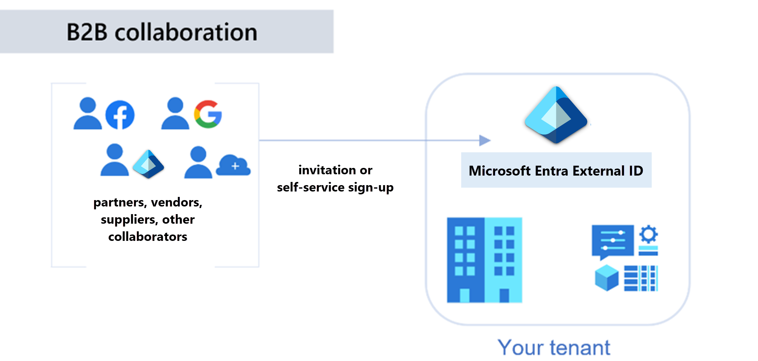
Microsoft Entra External ID B2B
Notes:
https://learn.microsoft.com/training/modules/describe-azure-identity-access-security/4-external-identities

Slide 45
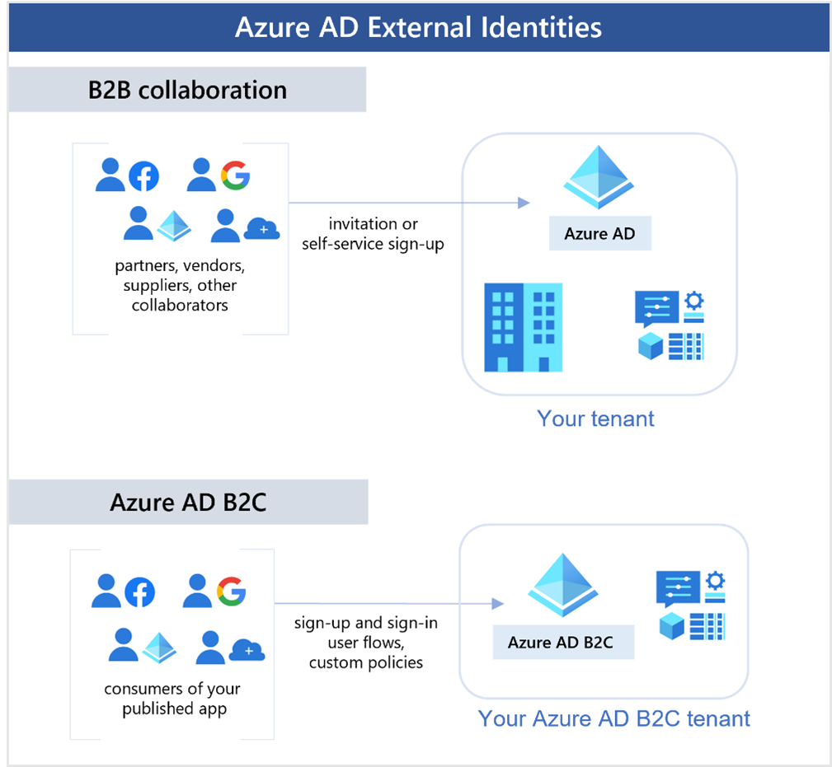
Azure AD External Identities B2C
Notes:
https://learn.microsoft.com/training/modules/describe-azure-identity-access-security/4-external-identities

Slide 46
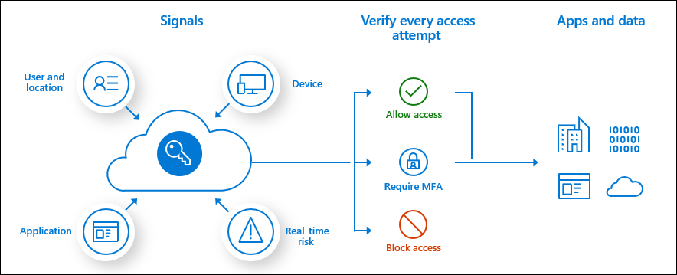
Conditional Access
Conditional Access is used to bring signals together, to make decisions, and enforce organizational policies.
User or group membership
IP location
Device
Application
Risk detection
Notes:
https://learn.microsoft.com/training/modules/describe-azure-identity-access-security/5-conditional-access
https://learn.microsoft.com/azure/active-directory/conditional-access/overview
The modern security perimeter now extends beyond an organization's network to include user and device identity. Organizations can utilize these identity signals as part of their access control decisions.
Conditional Access is the tool used to bring signals together, to make decisions, and enforce organizational policies. Conditional Access is at the heart of the new identity driven control plane.
At their simplest, Conditional Access policies are if-then statements. If a user wants to access a resource, then they must complete an action. Example: A payroll manager wants to access the payroll application and is required to perform multifactor authentication.
Administrators are faced with two primary goals:
Empower users to be productive wherever and whenever.
Protect the organization's assets.

Slide 47



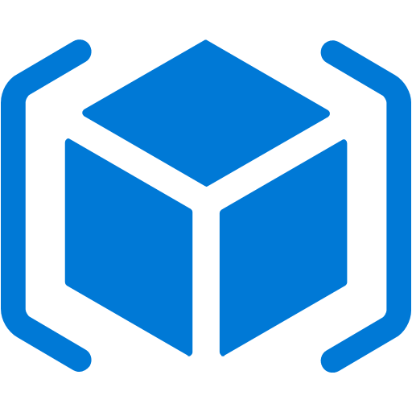
Role-based access control
Fine-grained access management.
Segregate duties within the team and grant only the amount of access to users that they need to perform their jobs.
Enables access to the Azure portal and controlling access to resources.
Microsoft Entra ID
Azure
subscription
User
Apps
User groups
Resource group
Resource group
Notes:
https://learn.microsoft.com/training/modules/describe-azure-identity-access-security/6-role-based-access-control
Azure RBAC: https://learn.microsoft.com/azure/role-based-access-control/overview

Slide 48
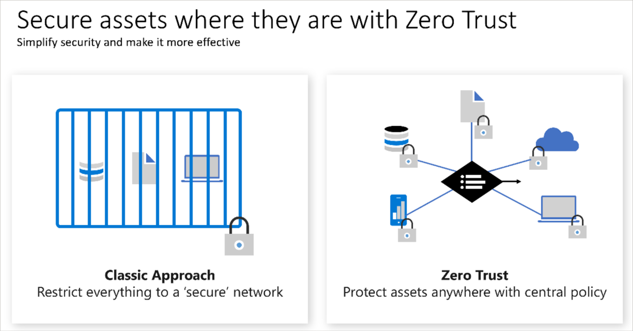
Zero Trust
Notes:
https://learn.microsoft.com/training/modules/describe-azure-identity-access-security/7-describe-zero-trust-model

Slide 49
Defense in depth
A layered approach to securing computer systems.
Provides multiple levels of protection.
Attacks against one layer are isolated from subsequent layers.
Physical security
Identity and access
Perimeter
Network
Compute
Application
Data
Notes:
https://learn.microsoft.com/training/modules/describe-azure-identity-access-security/8-describe-defense-depth

Slide 50
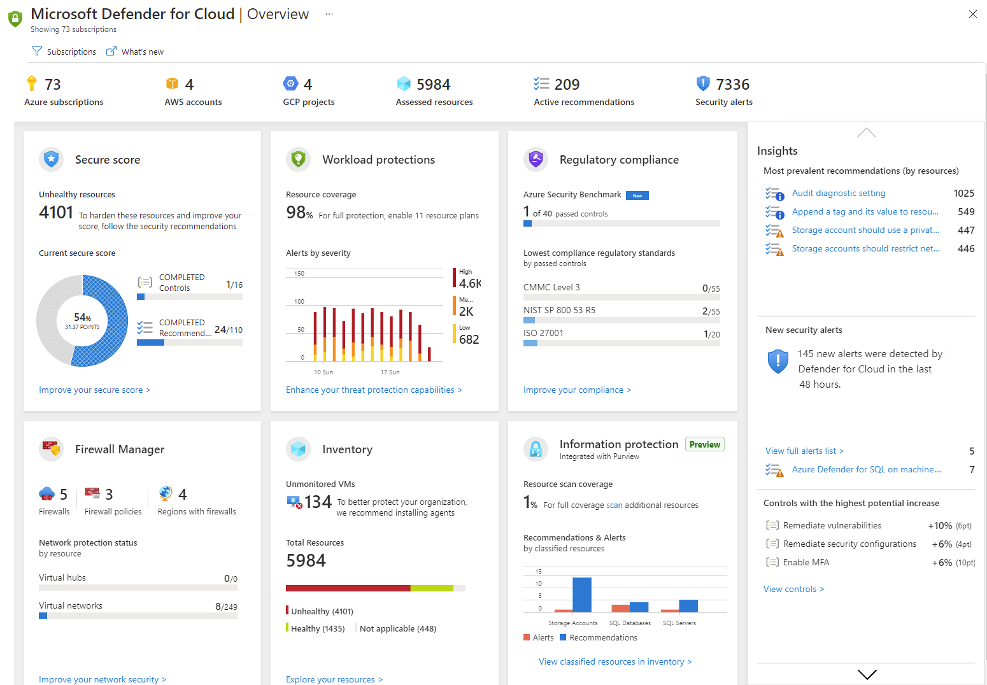
Microsoft Defender for Cloud
Microsoft Defender for Cloud is a monitoring service that provides threat protection across both Azure and on-premises datacenters.
Provides security recommendations.
Detect and block malware.
Analyze and identify potential attacks.
Just-in-time access control for ports.
Notes:
https://learn.microsoft.com/training/modules/describe-azure-identity-access-security/9-describe-microsoft-defender-for-cloud
Microsoft Defender for Cloud is a unified infrastructure security management system that strengthens the security posture of your datacenters and provides advanced threat protection across your hybrid workloads in the cloud―whether they're in Azure or not―as well as on-premises.
Strengthen security posture: Defender for Cloud assesses your environment and enables you to understand the status of your resources, and whether they are secure.
Protect against threats: Defender for Cloud assesses your workloads and raises threat prevention recommendations and security alerts.
Get secure faster: With Defender for Cloud, everything is done in cloud speed. Because it’s natively integrated, deployment is easy, giving you auto-provisioning and protection with Azure services.
Policy compliance: Defender for Cloud is built on top of Azure Policy controls so you can set and monitor your policies to run on management groups, across subscriptions, and even for a whole tenant.
Security alerts: Defender for Cloud automatically collects, analyzes, and integrates log data from your Azure resources, like firewall and endpoint protection, to detect real threats. The list of prioritized security alerts is shown in Microsoft Defender for Cloud along with the information you need to quickly investigate and remediate an attack.
Secure score: Defender for Cloud continually assesses your resources for security issues, then aggregates all the findings into a single score so you can tell your current security situation.
Microsoft Defender for Cloud: https://azure.microsoft.com/services/defender-for-cloud/

